Slide 1
Improving Network Connection Locality on Multicore Systems
Aleksey Pesterev et. al. MIT CSAIL. EuroSys 2012

Slide 2
TCP on Multi-core System
A task is completed on different cores
Incoming packet
the core receives the interrupt
Outgoing packet:
the core process the task
Inter-connection:
Access both the caches of the cores
Problems
More inter–core operations
Cache coherence problem
Interrupt
TCP Port
Core
Core
incoming
Core
Core
outgoing
Execute All Operations On One Core

Slide 3
Not Easy to Avoid Interactions
Connections on a TCP port is serialized
Avoid thundering herd
All the related activities on the same core: NOT likely
Scheduling
‘Connection on one core’ conflict with current scheduling
Parallelization
Applications
Different requests

Slide 4
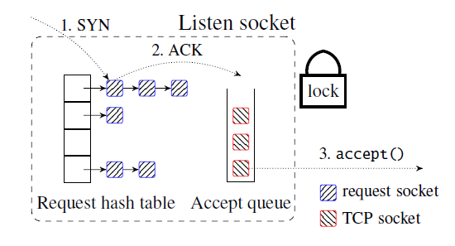
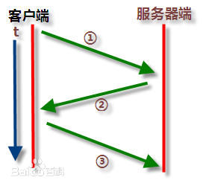
Example on Linux ---- TCP listen socket
Connection:
TCP 3-way connection setup handshake
One SYN and one ACK on each side
Track packet:
Hash Tabel
Accept Queue
Accept:
Itr -> core
Call accept()

Slide 5
Example on Linux ---- TCP listen socket
Challenge A: Single lock
Once a core to read incoming packet
Challenge B: Shared Cache Line
Process-core read cache line from input-core(may changes a lot)
Memory malloc/demalloc on diff cores

Slide 6
Solution: Affinity – Accept Architecture
Affinity – aware Listen Socket
Route same connections to same core
Sys Call
One queue per-core
Scheduling
For Load balance
NIC
Use Flow Direction (FDir)
Accept() only acquire from local queue
Stealing Policy
Tracking Busy Cores

Slide 7
Affinity–Accept: NIC – New routing solution
NIC – Ethernet interface
Routing incoming packet from connection to core
Target
Routing incoming packet from the same connection to the same core
Mechanism - Flow Direction
Hash
packet -> 64 DMA rings ( accept queue )
Flow group
flows with same hash value

Slide 8
Affinity–Accept: Sys Call
Sys Call
Accept packet from accept queue
Target
Accept local packet from local accept queue
Break the lock one queue per-core
One queue per-core
Core -> accept queue -> DMA ring -> hash value -> connection packet flow
Modify the system call
Accept()
Return connections from the local queue

Slide 9
Affinity–Accept: Scheduling
Target – Balance the load
Short term load spike
Load peak in a short time
Connection Steal
Long term load imbalance
Uneven distribution by NIC
Task accumulate
An extreme heavy task – load video
Flow Group Migration

Slide 10
Affinity–Accept: Scheduling
Connection Steal
How to steal:
State: busy/non-busy
Local queue length – waiting data
Modify the sys call: accept()
Acquire packet 5:1 (local data : busy core data)
What is busy:
Threshold: maximum local accept queue length
Hysteresis Defined:
Non-busy -> Busy: Instance Length > 75% thr
Busy -> Non-busy: Average Length < 10% thr
Flow Group Migration
Statistic the most likely to be busy
move applications totally (flow group)
?
Easy to busy, Hard to relax
Large Optimal Space

Slide 11
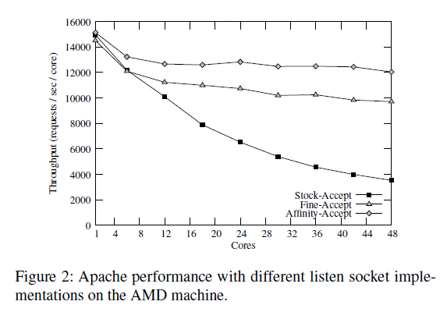
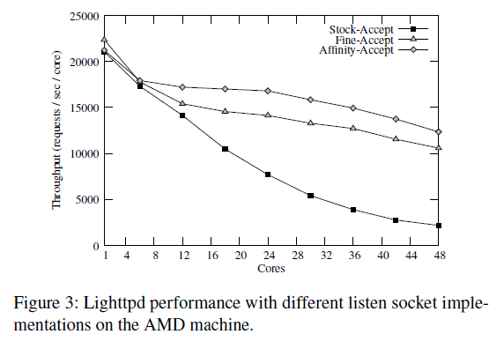
Experiments
Throughput: HTTP request/second
Increase 24% in performance
Notes:
2 – Hardware Base: 48 core AMD, 64 core Intel
2 – Applications : Apache, Lighted
a stock Linux listen socket : “Stock-Accept”
intermediate listen socket implementation ： “Fine-Accept” ： not aware of affinity

Slide 12
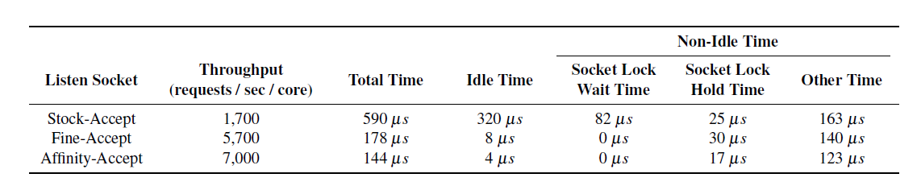
Experiments

Slide 13
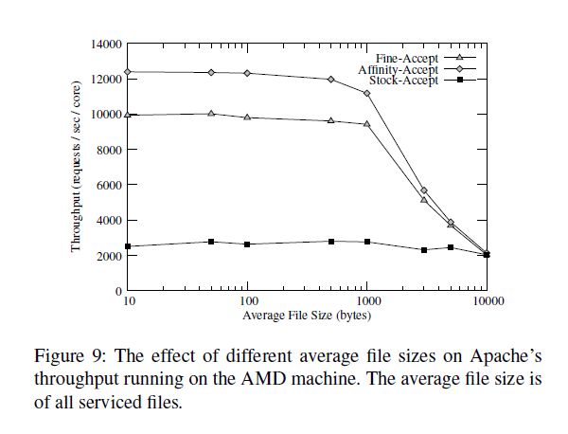
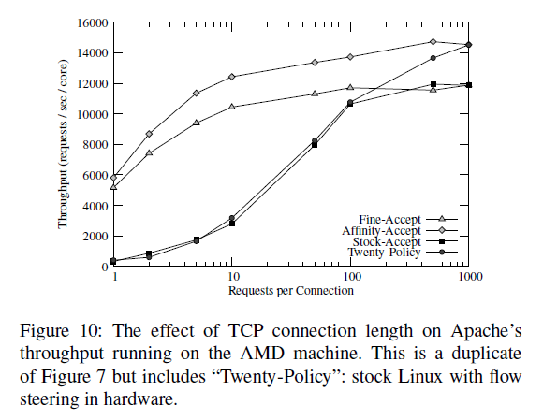
Experiments

